Slide 1
Insurance Board Introduction for Presbytery of Middle Tennessee Ministries
March 20, 2025

Slide 2
Topics
Insurance Board History and Origins
Who We Serve?
Covenantal Relationship with PC (USA)
Loss Control Resources
Group Program
How We Serve?
Introduction to Collier Insurance Agency

Slide 3
Insurance Board History
Organized in the early 1980’s in response to a challenging property and liability marketplace
In the early 1980’s it was difficult for churches to obtain adequate insurance
Started as a group purchasing organization, incorporated in 1985 as a 501 (c)(3) non-profit as United Church of Christ Insurance Advisory Board, later shortened to United Church Insurance Association
In 2001, United Church Insurance Company was incorporated and domiciled in Hawaii, becoming fully operational in 2002

Slide 4
Denominations Served
United Church of Christ – Founding denomination (UCCIAB in 1985)
Christian Church (Disciples of Christ) – Full Communion Partner (1991)
Presbyterian Church (U.S.A.) – Formula of Agreement (2009)
Alliance of Baptists – Partner in Mission (2016)
Evangelical Lutheran Church in America – Formula of Agreement (2018)
Reformed Church in America – Formula of Agreement (2018)

Slide 5
Insurance Board-A Covenantal Partner
Insurance Board is a program of Covenant
Insurance Board is a nonprofit organization serving only churches and affiliated ministries
Our Mission Statement reads, “To connect faith-based institutions to comprehensive and customized risk and insurance management solutions anchored in shared trust and sacred responsibility.”

Slide 6
Insurance Board a Recognized Partner
Insurance Board is recognized by the Presbyterian Church (U.S.A.) Office of Risk Management Services as one of only three insurance companies that meet their guidelines for churches, specializing in property and liability insurance for churches and related entities within the Presbyterian Church (USA).

Slide 7
Insurance Board a Recognized Partner
1500 PC(USA) churches and affiliated ministries served
Support of PC(USA) events such as:
General Assembly (Pre-Covid)
Synod Meetings
Presbytery Meetings
Mid Council Financial Conference
PCCCA (Presbyterian Church Camp and Conference Association)
APCE (Association of Partners in Christian Education)
Stewardship Kaleidoscope
Presbyterian Women
Youth Triennium

Slide 8
Safety Central
People
Property

Slide 9
The Steward - Quarterly Newsletter
The Spring 2025
Issue will be
Available Soon
Insurance Board Newsletter Archive - The Steward
Click the link above to view prior
issues of
The Steward

Slide 10
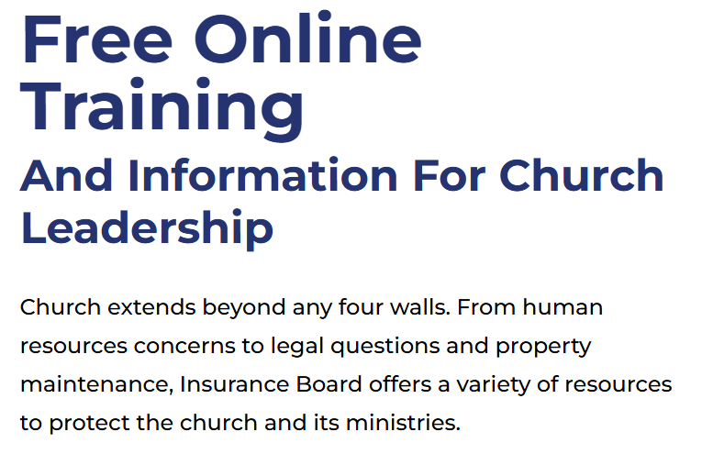
Online Learning – Webcast Resources
Online Learning Topics Include:
Online Leadership Trainings - Church Leadership | Insurance Board

Slide 11
Abuse Prevention Resources
Insurance Board’s SafeConduct™ Workbench offers a comprehensive toolkit to assist churches in developing a strong abuse prevention program with the following services:
Background Screening
Creating a Safe Environment (C.A.S.E.)
SAFECONDUCT™ POLICY
Praesidium Assessment Tool
Praesidium Academy

Slide 12
Human Resource Training Services
AIG EPL Pak
To help with the challenges presented to churches as a small business and employer, AIG provides employment practices liability (EPL) Primary policyholders a unique advantage with EPL Pak®Premier, industry-leading loss prevention offerings.
EPL Pak Premier’s resources are exclusive to AIG, and provide our EPL policyholders with access our eplriskmanger.com website.

Slide 13
Insurance Solution in a Hard Market:
Insurance Board remains dedicated to supporting ministries across all 50 states by providing comprehensive insurance and risk management solutions. We collaborate closely with presbyteries to develop (tailored) group programs designed to meet their ministries' needs. These group programs enhance the purchasing power of individual churches, allowing them to access high-quality coverage at more competitive rates.

Slide 14
How We Serve?
Insurance Board agents are exclusively appointed because of their understanding of, and compassion for, the churches we serve. Each one is an independent licensed professional. We are extremely honored to have each member on our team working to help you prevent loss and serving you if loss occurs.

Slide 15
Insurance Board Introduction for Presbytery of Middle Tennessee Ministries
March 20, 2025

Slide 17
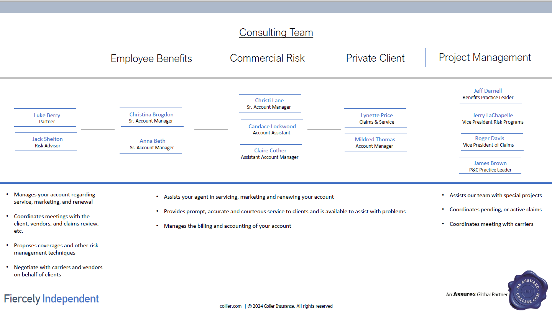

Slide 27
Contact Information:
Farnaz Ansari, VP
fansari@insuranceboard.org
S. Luke Berry, Partner
lberry@collier.com
Jack Shelton, Risk Advisor
jshelton@collier.com

Slide 28
THANK YOU www.insuranceboard.org

